Slide 1
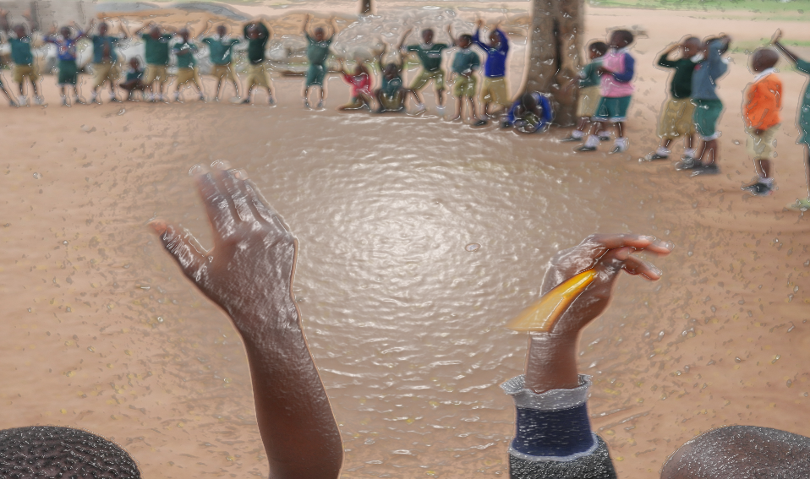
Learning Agenda
Fursa kwa Watoto (FkW) (Opportunities for Children)
The effect of FkW on teachers’ instructional practices, classrooms, and schools

Slide 2
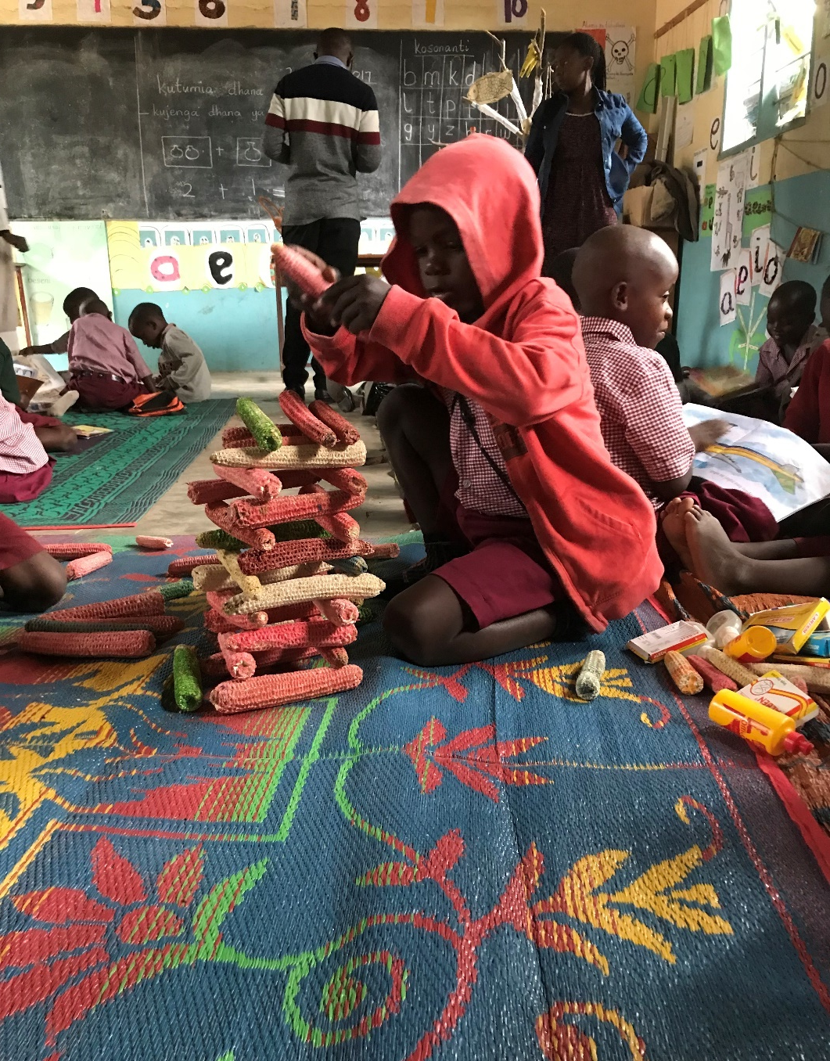
Outline
Pre-primary: promise and reality
Fursa kwa Watoto
The Learning Agenda
Research questions
Timeline and data sources
Teacher and classroom outcomes
Instructional strategies and skills
Lesson plans
Daily routine and child led activities
Class management and arrangements
Food programs
Classroom space and learning materials
School facilities
Spillover
Sustainability

Slide 3
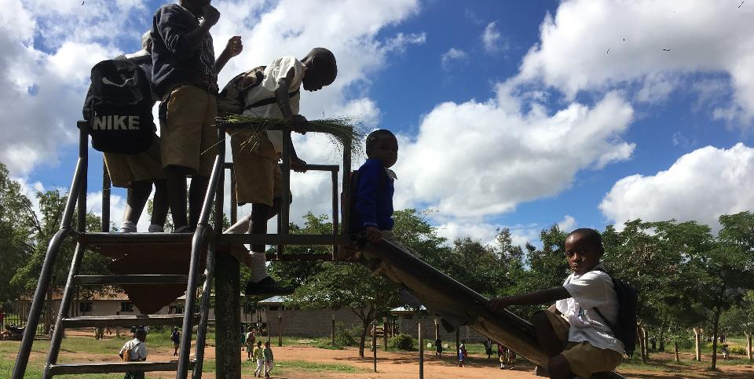
After training, teachers should apply new skills:
Learning Agenda evaluation questions:
How did FkW effect pre-primary instruction?
Is there evidence that FkW “spilled over” beyond intervention schools?
Is FkW sustainable?
Key findings: Classroom observations and qualitative transcripts

Slide 4
Instructional strategies and skills
FkW has improved instructional practices among intervention teachers. Control teachers are also gaining skills, particularly in Mwanza.
Note that training occurred in 2016 so the May scores are not true baseline. Intervention teachers had stronger performance due to FkW training.

Slide 5
Instructional strategies and skills:
Qualitative findings
Accomplishments
Challenges
Intervention teachers describe [and demonstrate] stronger instructional skills than control teachers.
Most intervention teachers continue to implement strong skills indicating some sustainability in practices.
Teachers reported implementing instructional skills such as the use of:
Clear introductions, linkages, and closure for lessons.
Formative checks, Q&A, and assessments with students
Time management
Varied teaching approaches and learning activities, and
Supportive learning materials.
The majority of intervention, pilot, and control teachers report needing additional training and support to implement quality instructional practices.
Teachers also report:
Lacking sufficient time to complete lessons for each subject
Needing additional teachers in class to allow the head teacher to work with small groups and individuals
Lacking the teaching and learning materials needed to support the lesson, and
The challenge of transitioning between lessons given large class sizes.

Slide 6
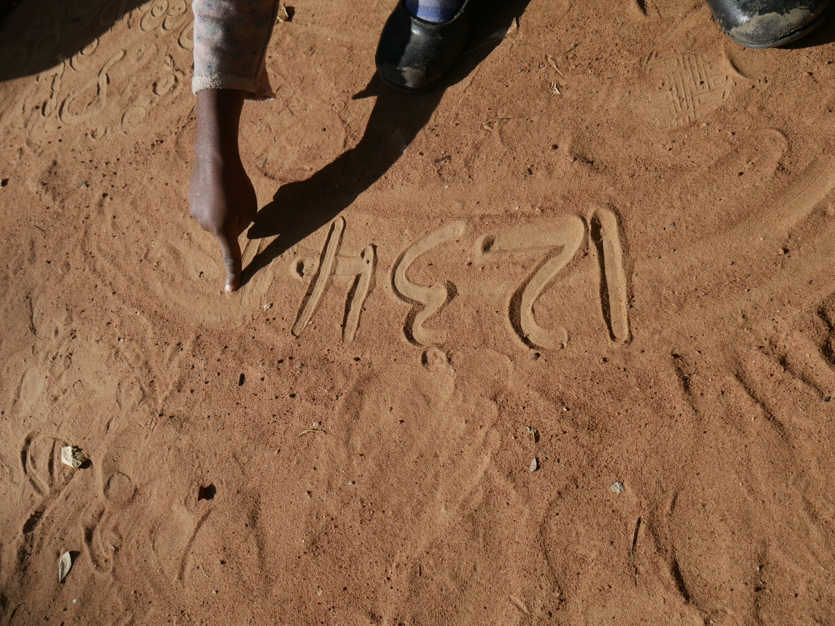
Lesson plans and instructional practices

Slide 7
Lesson plans by region
Lesson plans were scored on whether they had essential elements, objectives were clearly stated, the content was suitable, and teacher and learning materials were appropriate and supported the lesson.

Slide 8
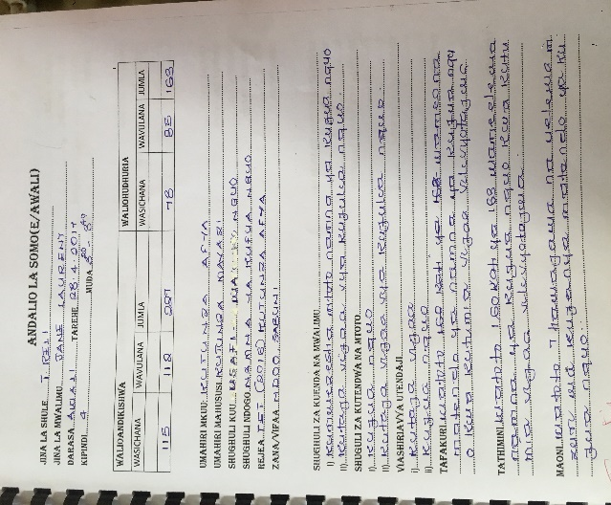
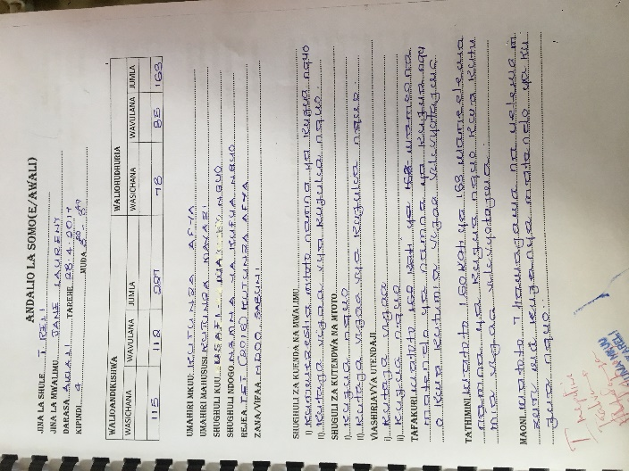
Lesson Plans:
Qualitative findings
Accomplishments
Challenges
Many teachers and head teachers can describe some components of the lesson plan.
FkW intervention teachers have a more advanced understanding of lesson plans compared to control teachers.
Despite the importance of plans, teachers struggle with plan development and implementation.
Challenges include:
Teachers lack time to develop and implement lesson plans on a daily basis. Time shortage due to:
Teaching multiple classes
Congested classrooms
Insufficient class time and school day to complete all the required lessons:
Short school day is due to child hunger when there are no meals, interruptions, high teacher to pupil ratio
Insufficient space, teaching tools, and learning materials for the lesson
Insufficient support and feedback on lesson plans

Slide 9
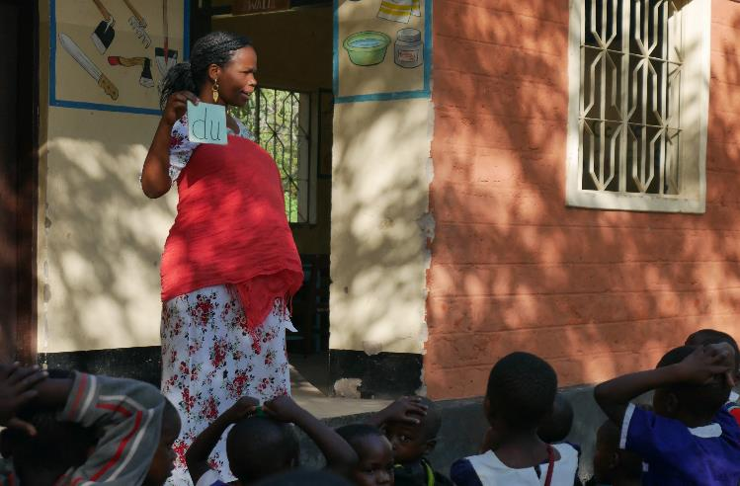
Lesson Plans:
Voices of respondents
“The challenge is when preparing. She might have many sessions, because she has other classes. So preparing for other classes as well as preprimary is a major challenge.”
Head Teacher
“I need support to prepare the plan … and also more training on how to prepare my lesson plan.” Teacher
“The teacher could perform well. His lesson plan is very detailed and clear but when he gets to class, he meets so many students…it’s a challenge to implement the prepared lesson plan. He plans to attend students individually to write the letter “a”. How will he implement if he has 80 students and has only 15 minutes?”
Head Teacher
“Frankly there is nobody who supports me.” Teacher
“Honestly I get very tired. I stay far away [from lesson planning].” Teacher

Slide 10
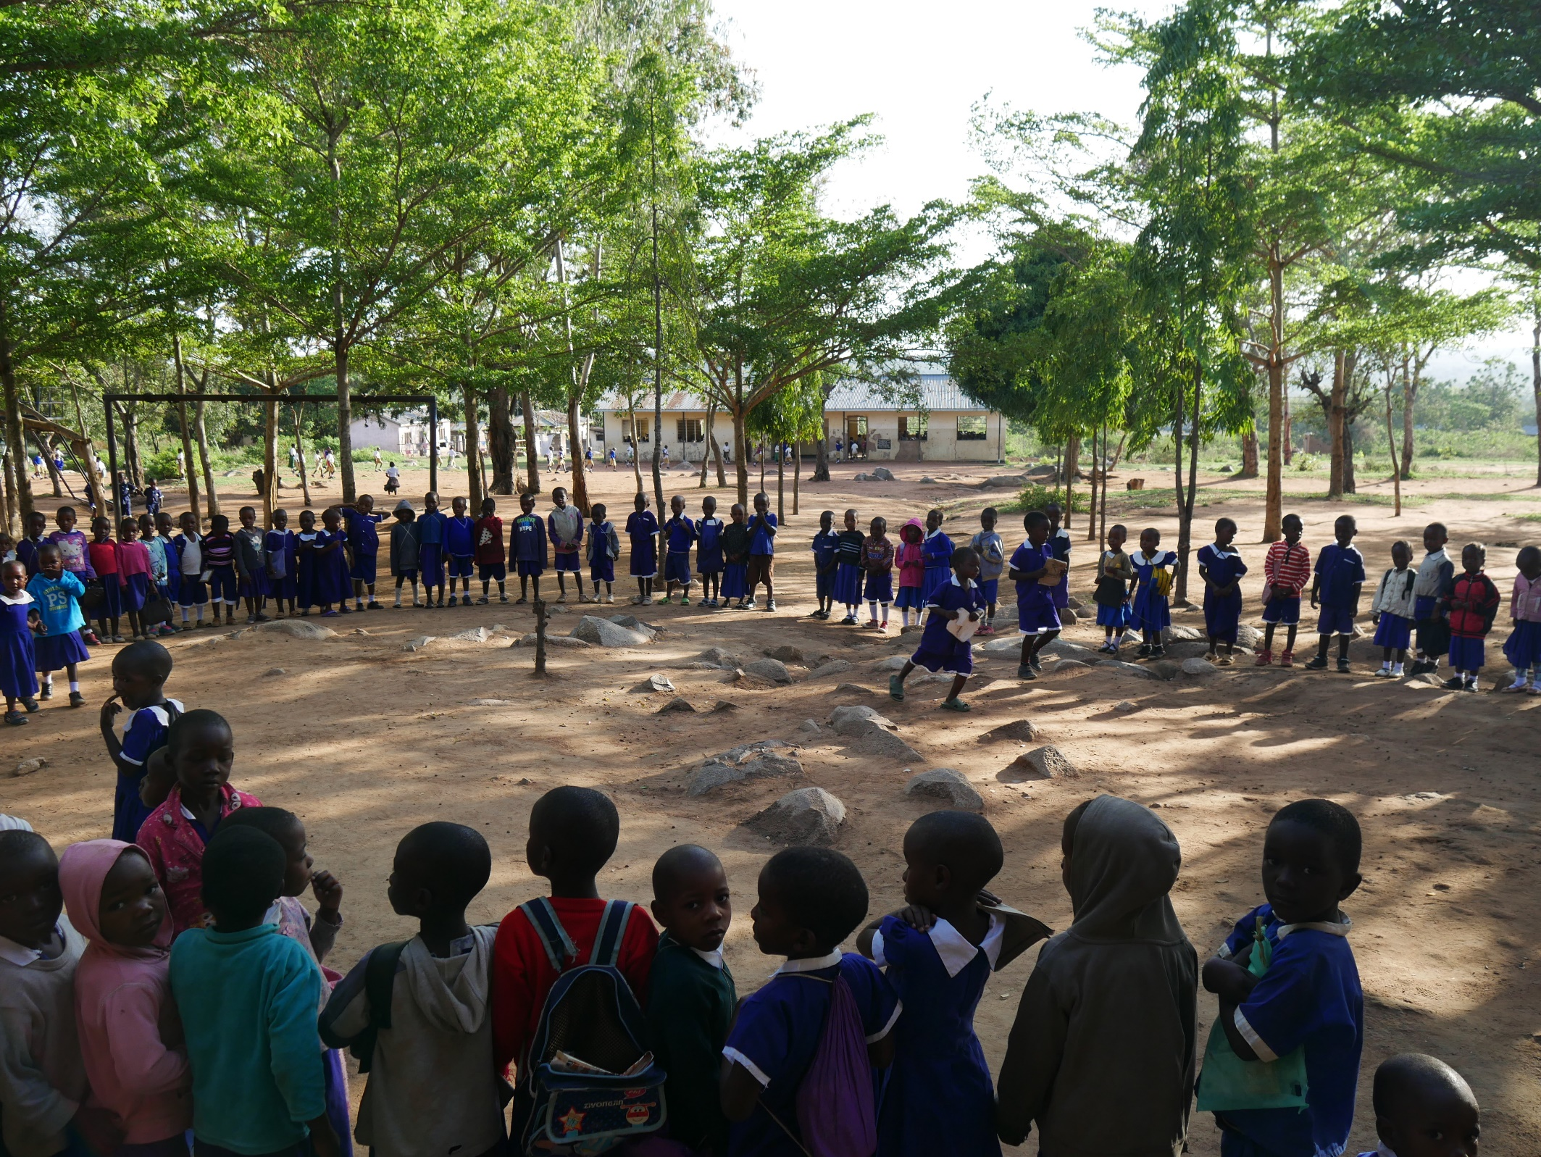
Daily routine and child-led activities

Slide 11
Child-led activities
The overall decline in child-led activities likely results from increased enrollment, and shortages in teachers, classroom space, and learning materials.
The gap between intervention and control teachers demonstrates the impact of FkW.

Slide 12
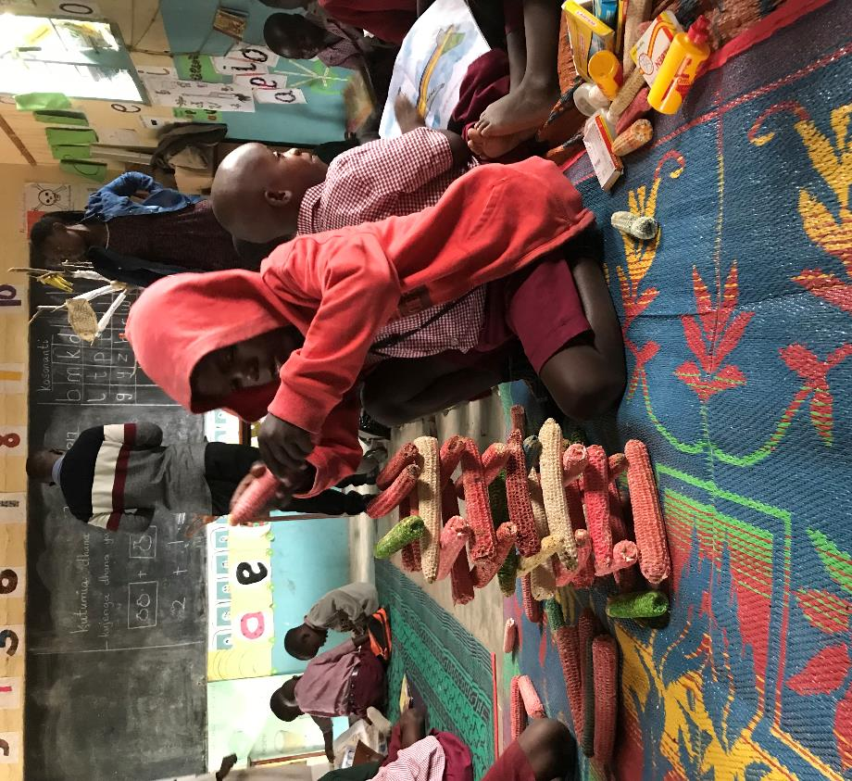
Child led activities:
Qualitative findings
Accomplishments
Most teachers recognize the value and strive to implement child led activities
Challenges
Again, challenges to implementation include:
Congested classrooms, and
Teacher, space, and material shortages.
“There are barriers in implementing multiple approaches in the class as the students are many that some of the approaches are impossible. Truly many of the approaches are impossible because of the huge number of the students.”
Teacher Mwanza

Slide 13
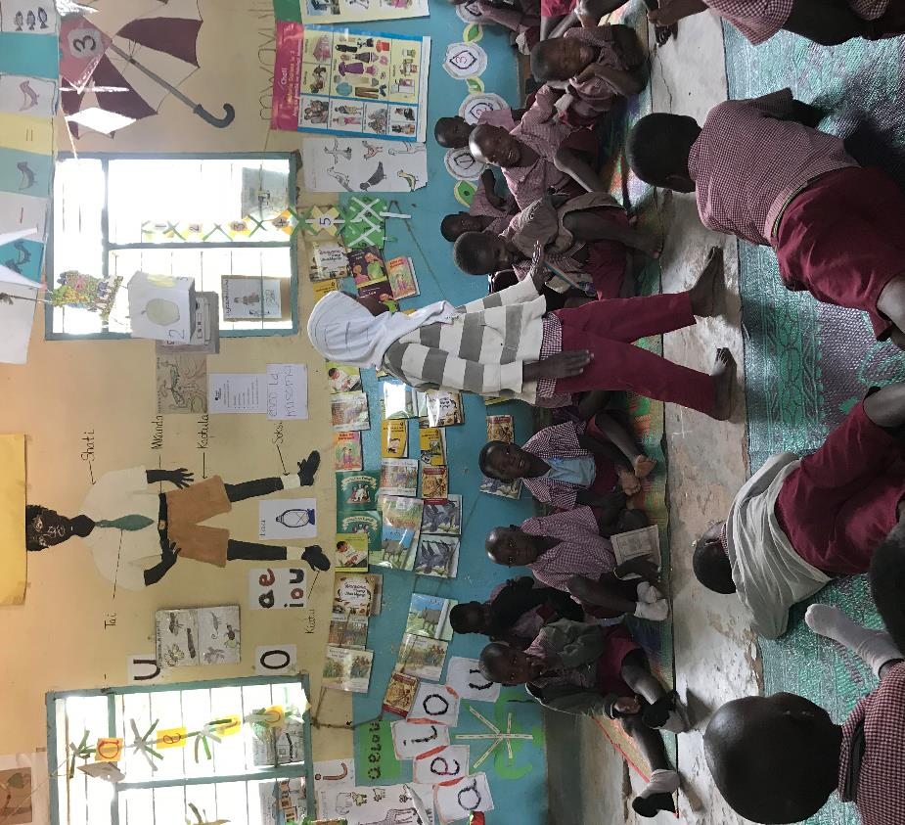
Child led activities:
Voices of respondents
“I use the approaches. I was taught that you should draw your materials as big and colorful as it can to make it attractive. You can take the students out and teach them by actions and games where you participate in those games. At times you give students chances to talk and play with you.”
Teacher Moshi
“It’s important because without them being interactive then the goals won’t be reached. When children participate effectively then the goals will be reached effectively.”
Teacher Mwanza
“[Child led activities] makes the teaching process easier because children can learn on their own.”
Teacher Mwanza

Slide 14
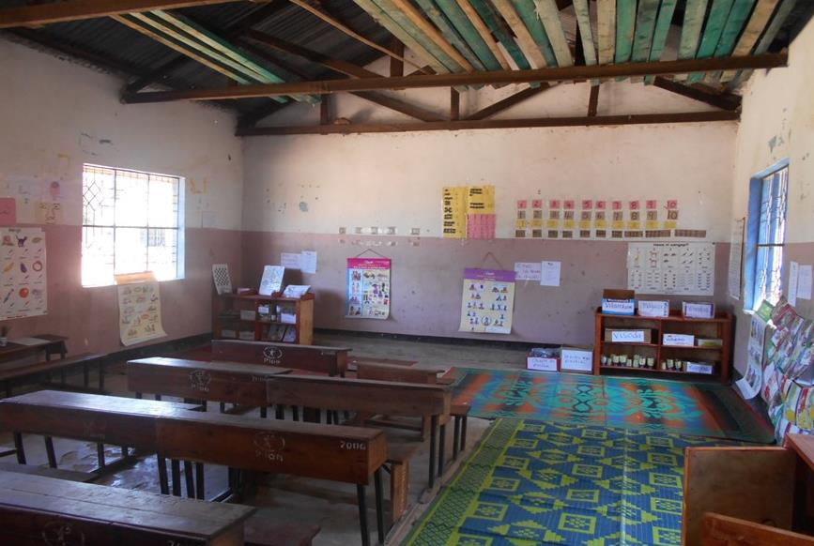
Classroom management and arrangements

Slide 15
Classroom management and climate
Classroom management has improved in both regions since the baseline in 2014.
In Mwanza, the control schools are closing the gap with intervention schools. This is likely due to education officials working to implement FkW at all schools.

Slide 16
Classroom arrangements and management: Qualitative findings
Accomplishments
Challenges
Most intervention schools continue to implement strong classroom management practices.
Teachers describe how they manage classrooms using strong instructional practices, participatory methods, learning materials, and by developing positive relationships with students.
Many teachers overcome challenges because they love students and teaching.
Classroom space is insufficient to manage class effectively.
Congested classrooms limits teachers’ ability to implement best practices.
Pre-primary classes share space with other grades.
Teachers face behavioral problems when classrooms are overcrowded and lack learning materials and when students are hungry (in the absence of feeding programs).

Slide 17
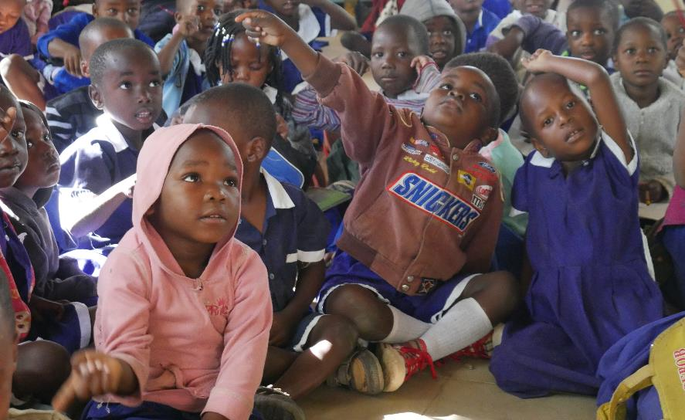
Classroom arrangements and management: Respondent voices
“The big challenge we are facing is over crowdedness in the classrooms… The teacher has nowhere to step. We have schools where this is a very huge challenge.” QAO Mwanza
“The rooms are small and students are many. Even if I advise the teacher on how to put children in the learning corners, it is like you are just talking, but it is difficult in the implementation.” QAO Moshi
“I think the challenges have been those recurring ones… pre-primary has been sharing the classroom with other classes.” DAO
“One example … these classrooms were not prepared for those children, so the infrastructure is not good.” DEO

Slide 18
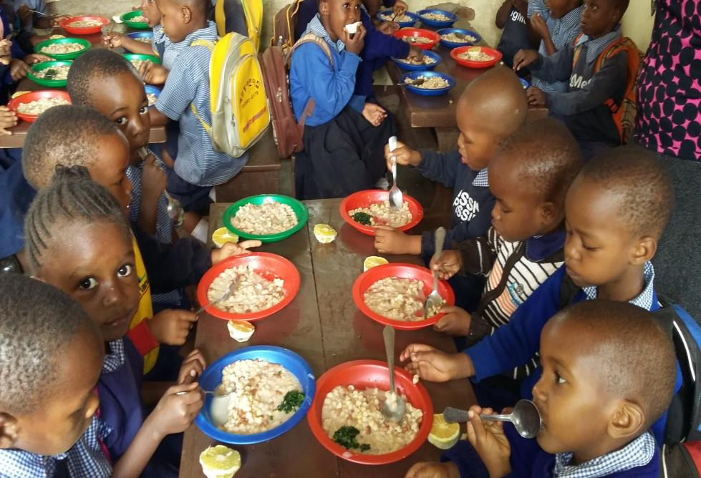
Food programs

Slide 19
Schools providing food by region
In Mwanza, the fee free education policy and “contribution” policies have severely impacted school feeding programs.
Head teachers, SMCs, and WEOs have worked to educate communities that children need school feeding programs. Intervention and control schools have made progress in 2018.
In Kilimanjaro, control schools have led in meal provision though intervention schools are gaining ground.
The regional gap in food programs is stark.

Slide 20
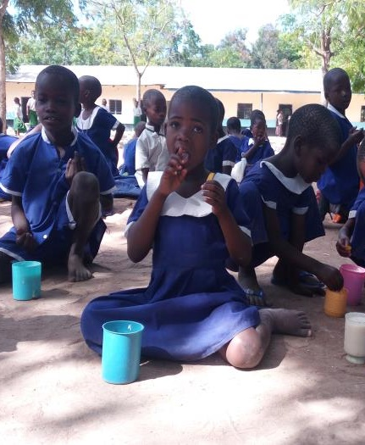
Food programs:
Qualitative findings
Findings
All school officials recognize the importance of school feeding to child learning.
While some Kilimanjaro families stopped food contributions—following the fee free and “contribution” policies—officials were able to quickly sensitize parents to avoid too much disruption.
In Mwanza, some schools have succeeded in restoring or adding food programs. Intervention schools have led the way.
Challenges
The majority of schools in Mwanza still lack feeding programs.
The lack of food severely undermines quality pre-primary as students are hungry, the class day is reduced, and there is less time on learning.

Slide 21
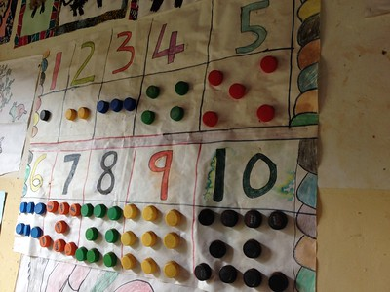
Classroom space and learning materials

Slide 22
Classrooms with enough space
The gap between intervention and control schools demonstrates the impact of FkW. Head teachers, teachers, SMCs and community members have worked to build classrooms and ensure pre-primary classes have adequate space
Even control schools have realized the benefit of pre-primary education and ensuring classroom space for pre-primary.

Slide 23
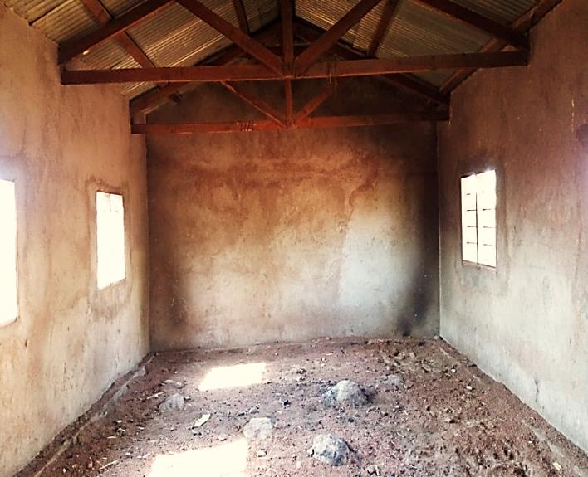
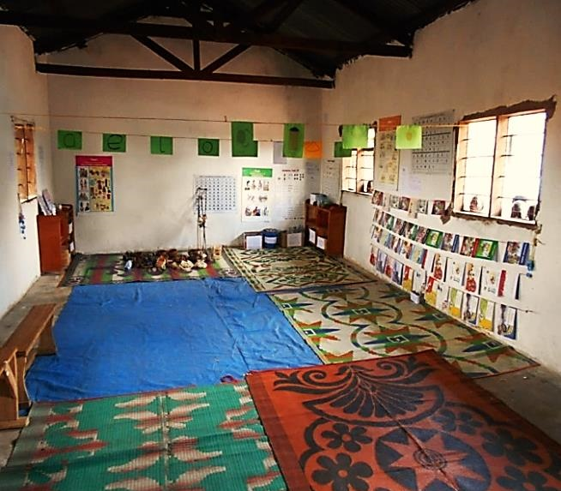
Classroom space:
Qualitative findings
Accomplishments
Challenges
Intervention and control schools have improved the classroom learning space.
Clear evidence of FkW spillover from intervention to control schools.
TIE training—using FkW principles—also emphasized the value of pre-primary.
Intervention and control schools still report space shortages, particularly in Mwanza.
Teachers are unable to implement some lessons due to space issues.
Before and After photos of same classroom: Mwanza, TAHEA

Slide 24
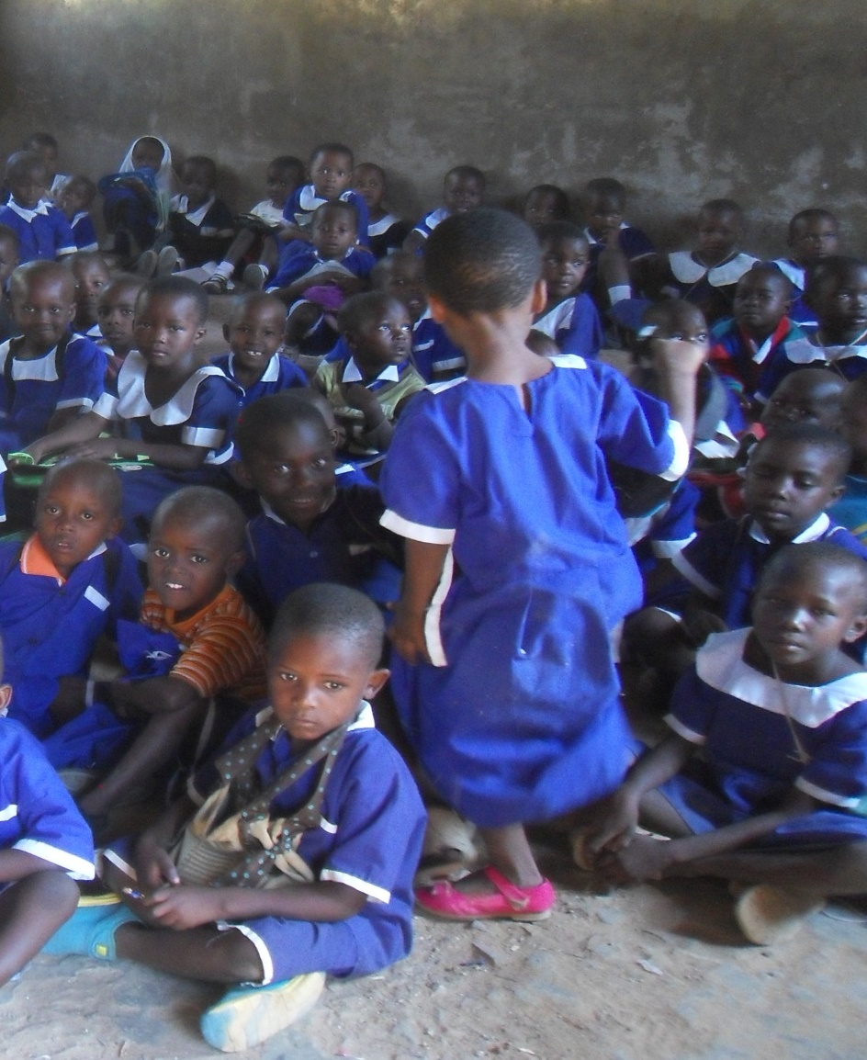
Classroom space:
Qualitative findings and respondent voices
“The big challenge which we are facing is over crowdedness in the classrooms until the teacher has nowhere to step. We have schools which this is a very huge challenge … If we got classrooms it will be so nice. Good classroom with windows and doors, painted walls and nice roofs. The main challenge in my district is infrastructure. The teacher may be trained but the environment might be a challenge in doing their work effectively. ”
QAO Mwanza

Slide 25
Learning areas
Again, the gap between intervention and control teachers demonstrates the impact of FkW.
However, while control schools in Mwanza are improving learning areas, intervention schools in Mwanza and Kilimanjaro are scoring lower, indicating that sustaining quality learning areas has been challenging.

Slide 26
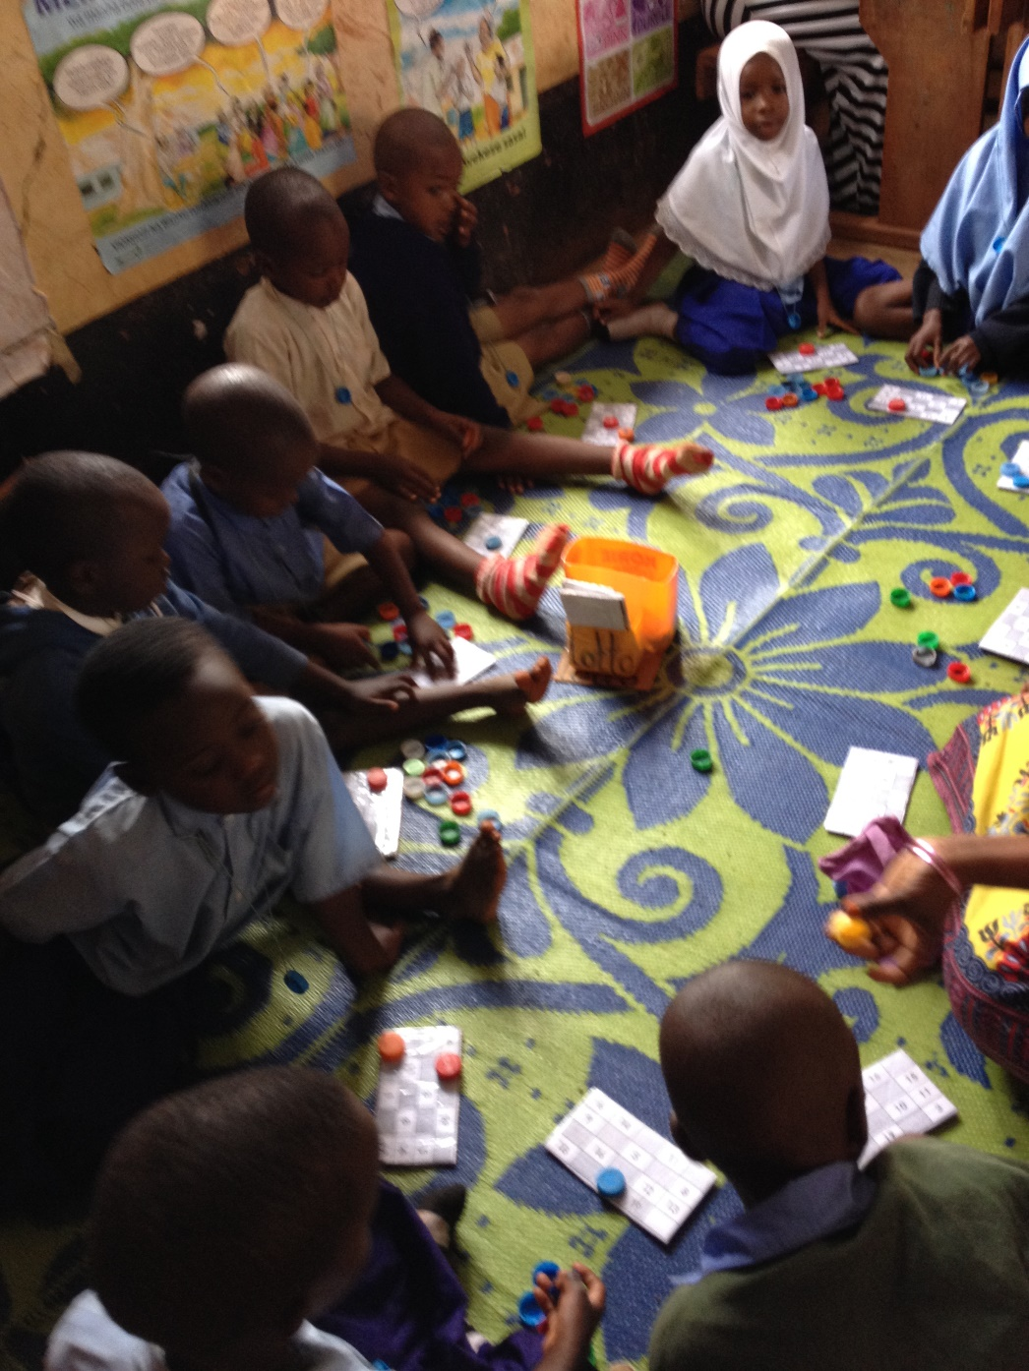
Learning corners:
Qualitative findings and respondent voices
Accomplishments
Most respondents understand the value and importance of learning corners.
Most schools have organized learning areas.
Some teachers, school and parent communities, particularly in Kilimanjaro, work together to prepare materials for learning corners.
Teachers report that students “learn by themselves” when they have well organized and stocked learning corners.
Challenges
Many schools lack sufficient space for learning corners.
Many teachers lack the time to organize learning corners.
Short school days limit the time children have in learning corners.

Slide 27
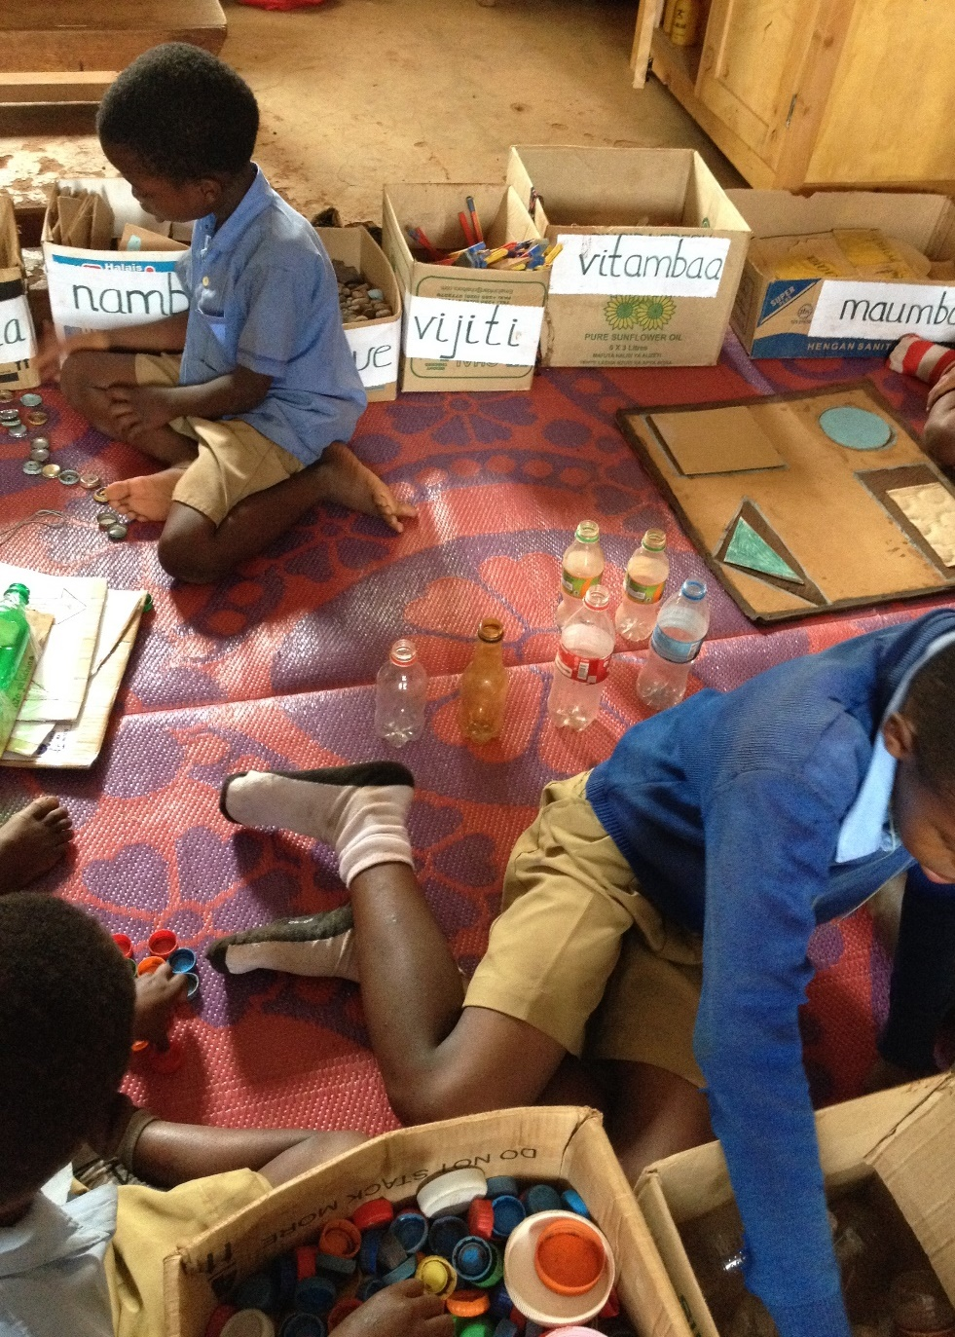
Learning corners:
Respondent voices
“The training made me see the importance of the areas. Those areas help students gain skills in interacting and relating when they meet, stay, and play together.”
Teacher Mwanza
“I prepare my approaches during the weekends or nights at home. If this is impossible then I will take students of standard six and seven during the break times. If it is drawing then I will find one to help me draw then I will color.” Teacher Moshi
“The learning areas are not sustainable and some of schools don’t put them anymore because some teachers complain that a classroom is small for putting the learning areas.” QAO Moshi
“What motivated me is that pupils like it. They are attracted to those areas. They like to learn themselves. When you put them in those groups they perform. Those who want to count, will count. Those who want draw, will draw. Those who want a book take a book.”
Teacher Moshi

Slide 28
Sufficient learning materials
While sustainable in some schools, in both regions, fewer intervention schools had sufficient learning materials over time.
In Mwanza, the gap between intervention and control teachers is narrowing as control schools make significant gains. In Kilimanjaro, less than 1 in 10 control schools made learning materials accessible.

Slide 29
Learning materials:
Qualitative findings
FkW classrooms continue to be child-centered learning environments.
Teachers request the basics: manila cards, markers, paper
Sustainability is challenged by the teacher shortage, inadequate school financing, and parents low motivation to engage with pre-primary.
Many teachers are creative in finding and making appropriate learning materials.
Most learning materials are made by teachers using locally available, low-cost materials.
Some teachers use their own salary to purchase materials.
In some schools, teachers work with head teachers, teachers from other grades, students, parents, and SMCs to develop materials.

Slide 30
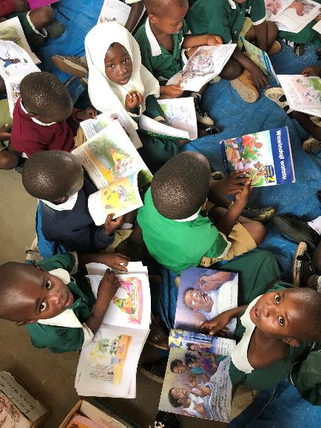
Learning materials: Respondent voices
“I need materials. I really need them for children to learn.” Teacher Mwanza
“The quality of preprimary education will come from teaching materials, you can plan how you want a class to be but if the teaching materials are not available at the time they are needed just because of shortage of money, we fail to reach the quality we set to achieve.”
WEO Moshi
“Since I love this class, I usually end up buying them myself. If the school gets the money and makes plans to buy those materials, like manila cards, marker pens, they’d help me a lot. The manila cards and marker pens come only twice a year but the pre-primary class needs these materials more often than that.” Teacher Mwanza
“It’s the assistance in preparing them [that the teacher needs]. And time, especially time as I have to prepare what I will teach and which learning material I will use. So you may find the time to prepare some learning material is not enough due to a high workload.”
Teacher Moshi

Slide 31
Schools with open pit latrine
The majority of schools in Mwanza still have an open latrine, unsuitable for pre-primary aged children. The percentage of control schools in Kilimanjaro with open latrines has declined, while the percentage of intervention schools in Mwanza has increased.

Slide 32
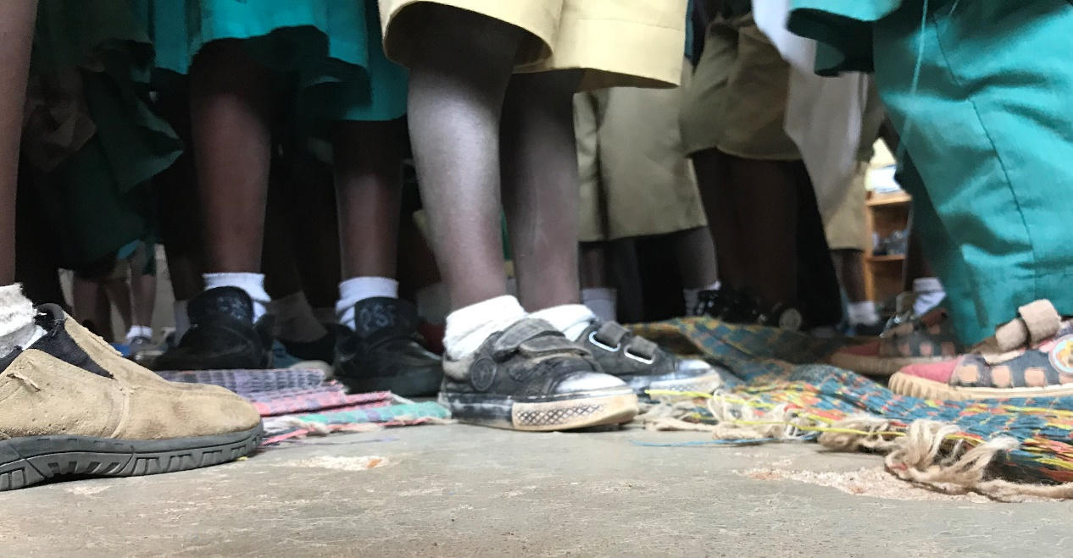
Infrastructure and space: Qualitative findings
Schools in both districts face struggles with infrastructure which undermine student learning and safety.
The increase in enrollment following the Fee Free policy was not accompanied by a corresponding increase in resources for capital expenditures.
Schools that built and renovated classrooms and latrines benefited from active SMCs and education officials working with communities to identify financial and human resources for the infrastructure.
“I think the challenges have been those recurring ones. It’s not every school that has classrooms for preprimary. They have been sharing the classrooms with other classes.”
DAO
“There ought to be complimenting infrastructure development. For example we have pit latrines which are not very friendly. Children need proper, hygienic toilets. Sometimes the children end up messing their pants in class because of the condition of the toilets.” DAO
“The challenges include infrastructure, classrooms and toilets, offices for teachers, houses for teachers and canteens. It’s a big challenge when there is inadequate infrastructure at the school because it slows down development. When there is inadequate sanitary infrastructure, you can imagine a primary pupil going the whole day without answering the call of nature or using facilities which cause the spread of disease.” DEO

Slide 33
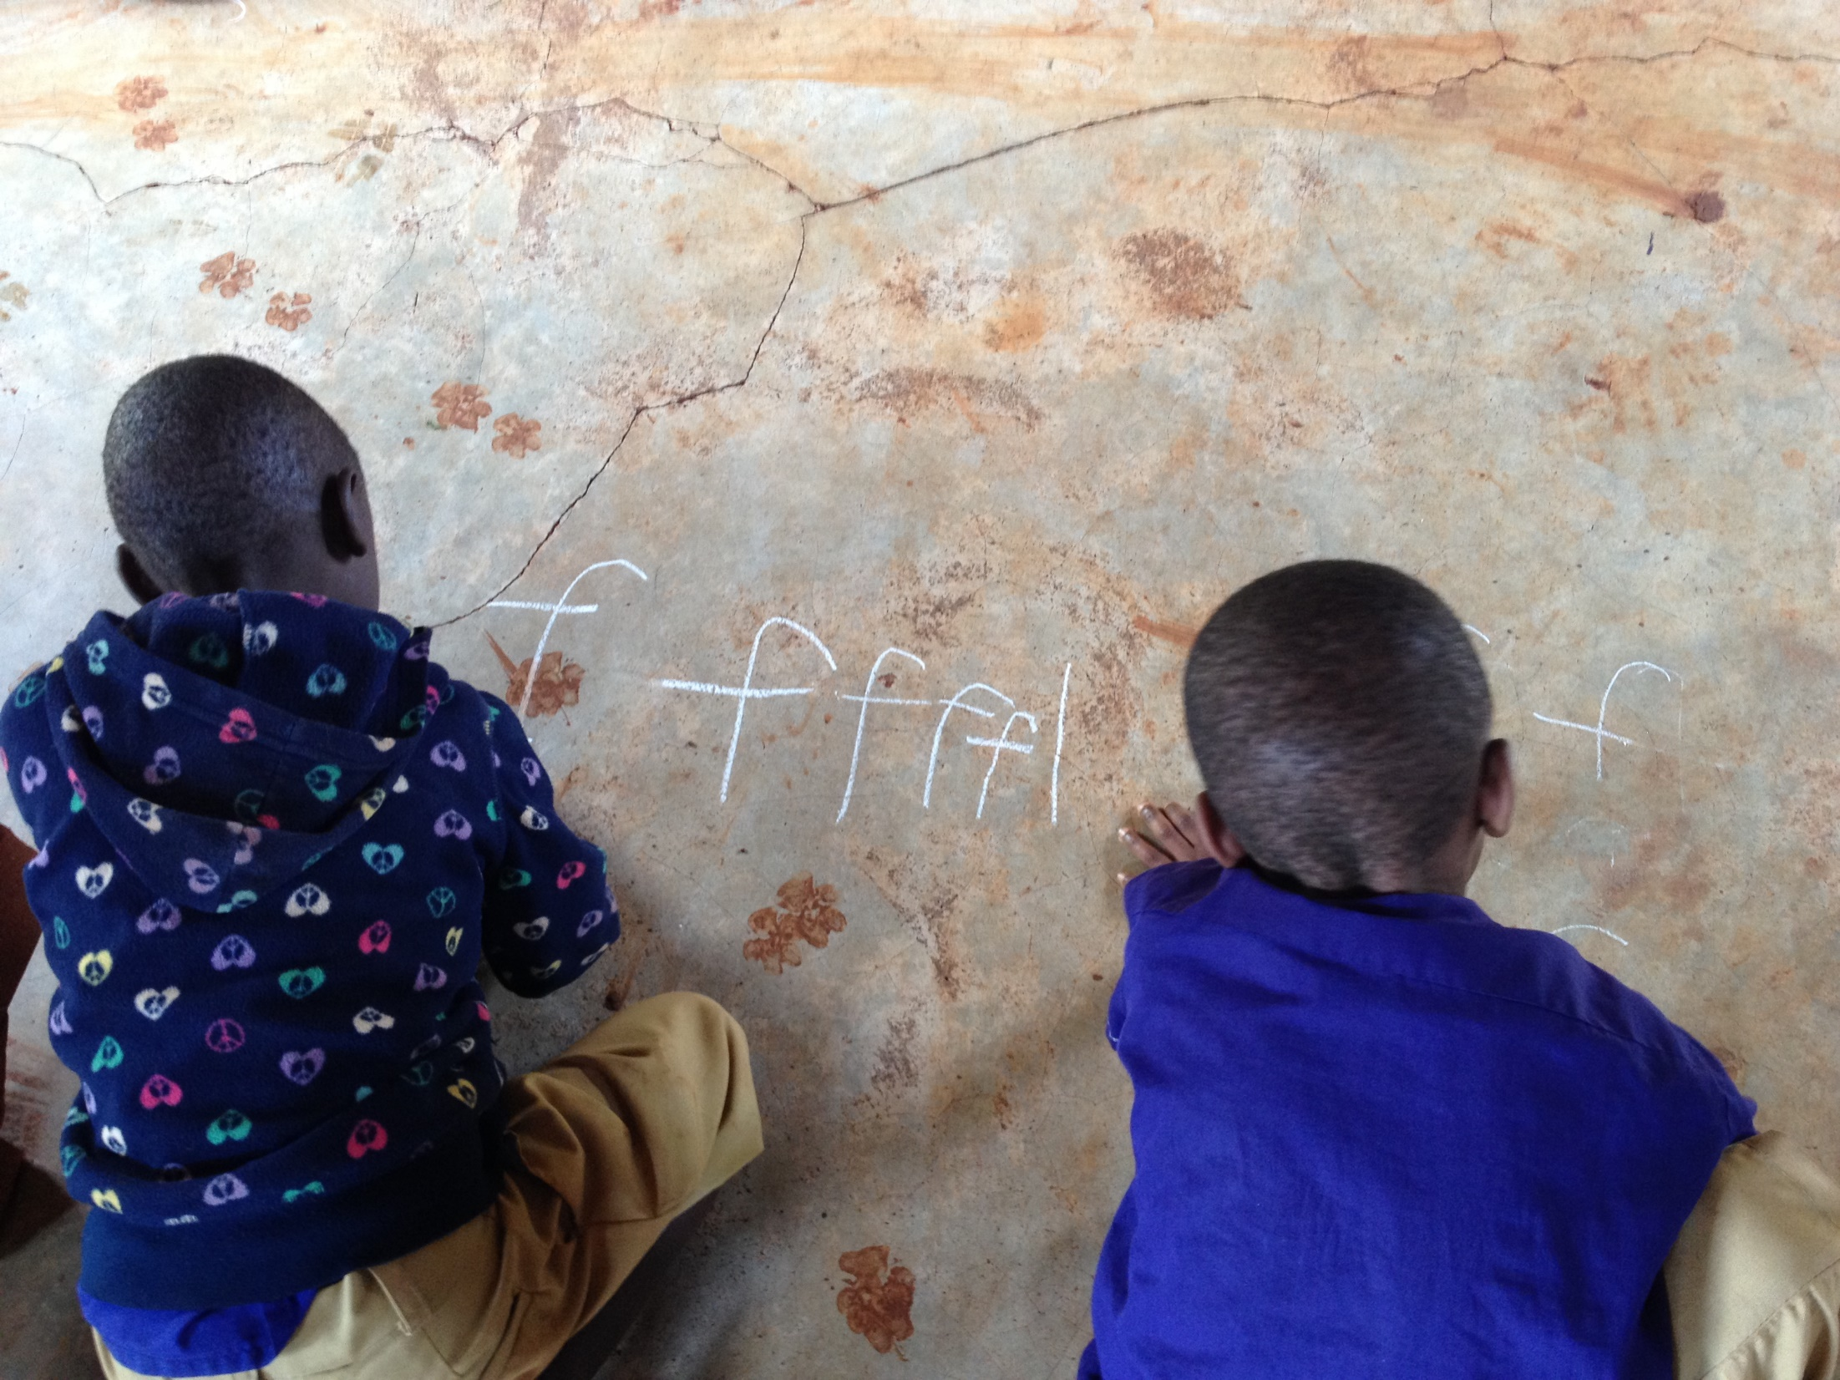
Context
Infrastructure shortage:
Respondent voices
“The government policy says that every class should have 45 to 50 students. But when you calculate the number of classrooms you find that our schools have a scarcity of classrooms. Most of the schools have a shortage. A school can have a deficit of 10 to 40 or up to 50 rooms. How will they build and where will they build them? We all do not know.” QAO
“Some of the challenges that I have seen are that the room is too small, therefore limiting the learning activities. The classroom is very small and you find that the instructions on how to do certain activities are not enough.” Head Teacher Mwanza
“There are a lot of barriers for example the classroom for the preprimary class is very small such that when the teacher would like to use some teaching and learning aids, but it’s not possible because the room is small. The number of pupils is too big...” Head Teacher Mwanza
“These classrooms were not prepared for those children, so those infrastructures are not good. Secondly, we also have a shortage of latrines so they have to share the available ones with the older (primary) pupils. Additionally there is a shortage of playing space for the children.” DEO
“The challenges in our classrooms… to be honest some of the rooms are small and students are many. So you see even if I advise the teacher on how to put children in the learning corners, it is like you are just talking because you must talk. It is difficult in the implementation. It is difficult for those students to show their talents. This child is capable in this area but … Also on teachers side they reach a point...” QAO
“STD 1, STD 2, and preprimary share one classroom. Preprimary and STD 1 share the same classroom at the same time. However at 10 am, the preprimary class will be dismissed. As we speak, they have already been dismissed. We only have STD 2 right now because the preprimary class have also been dismissed after sharing the class with the STD 1 class.” Head Teacher

Slide 34
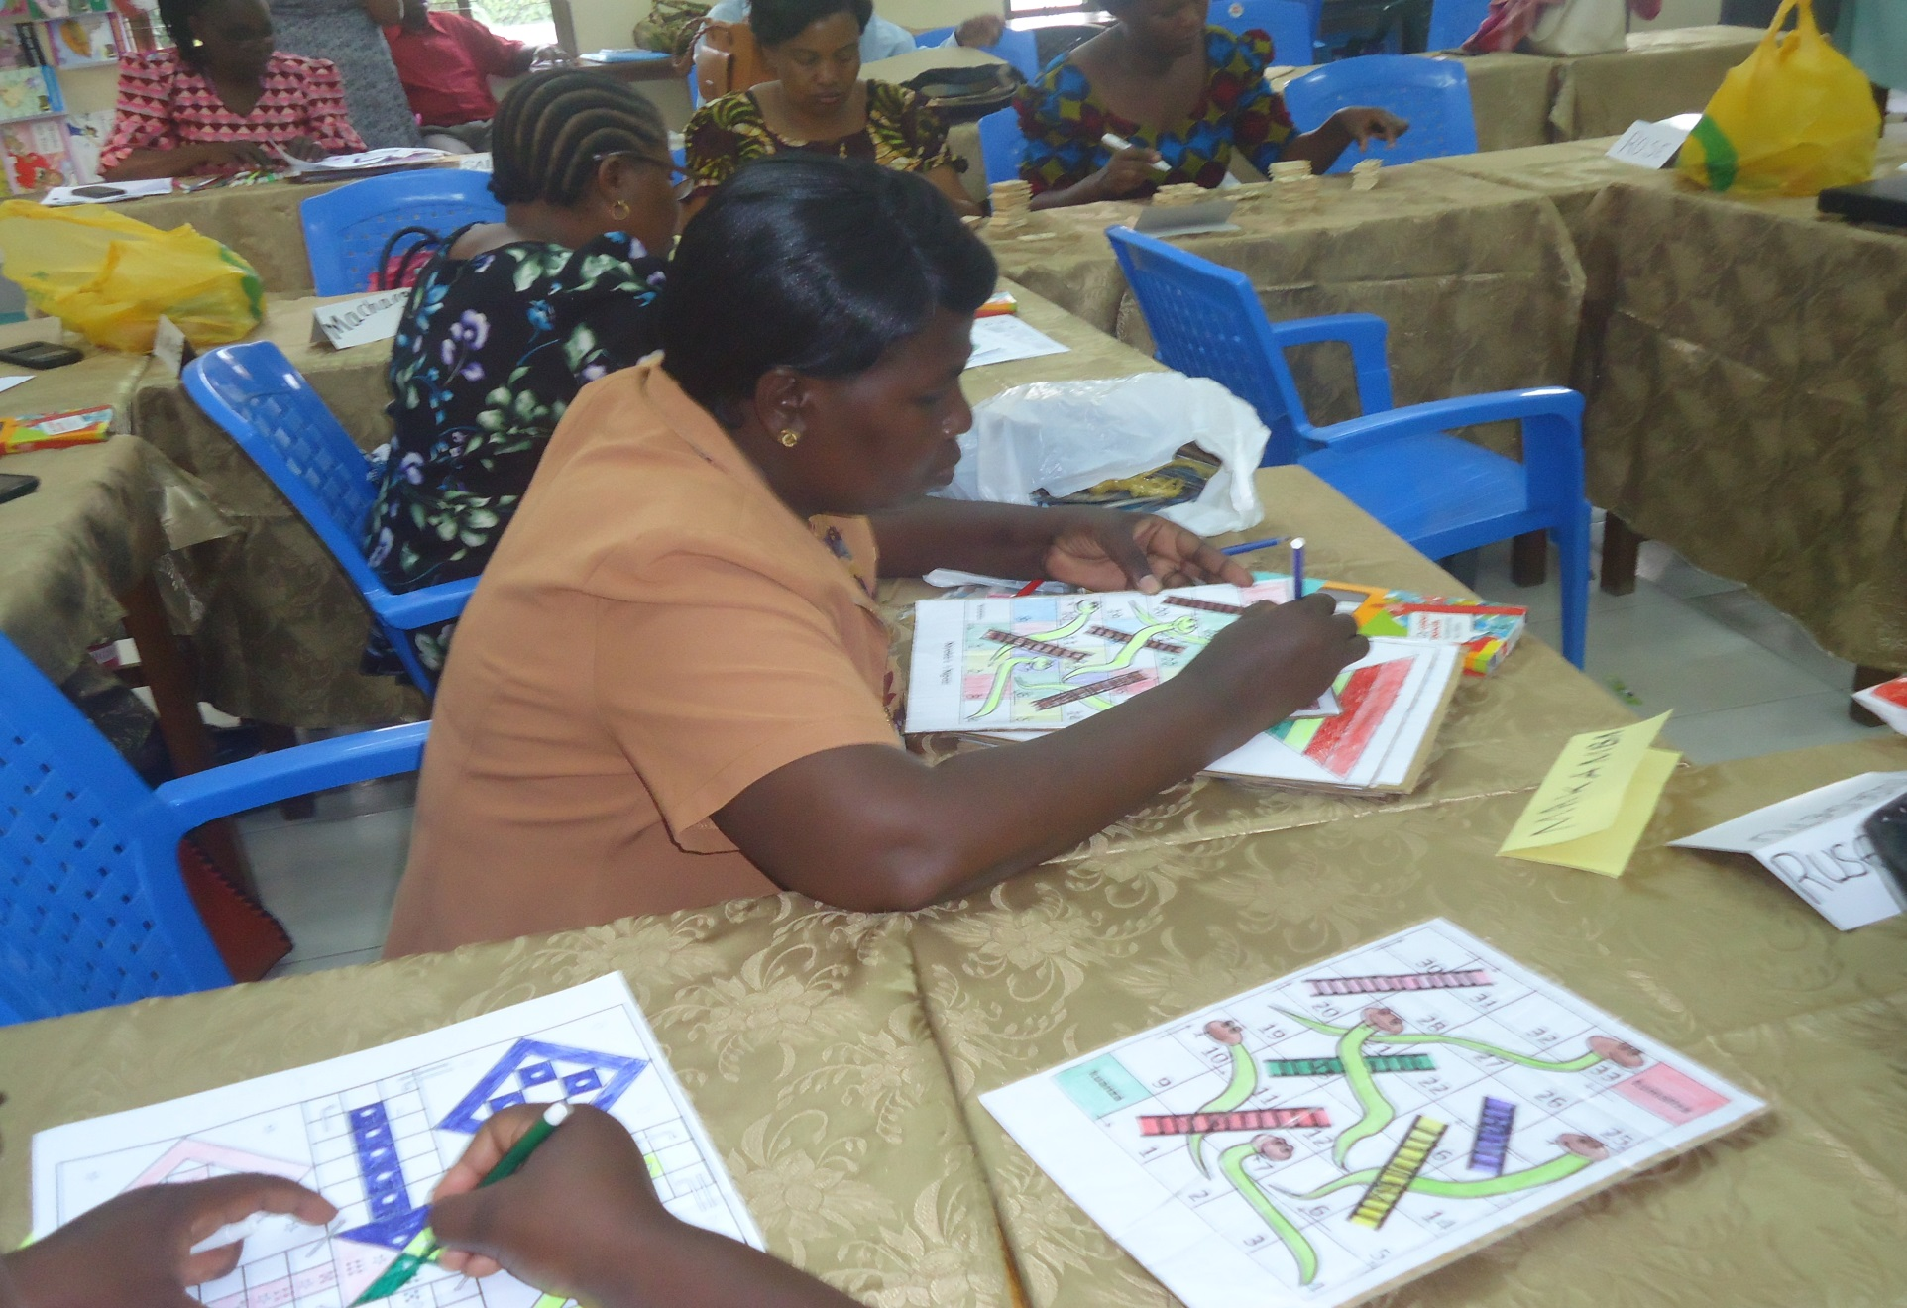
Spillover and support for pre-primary

Slide 35
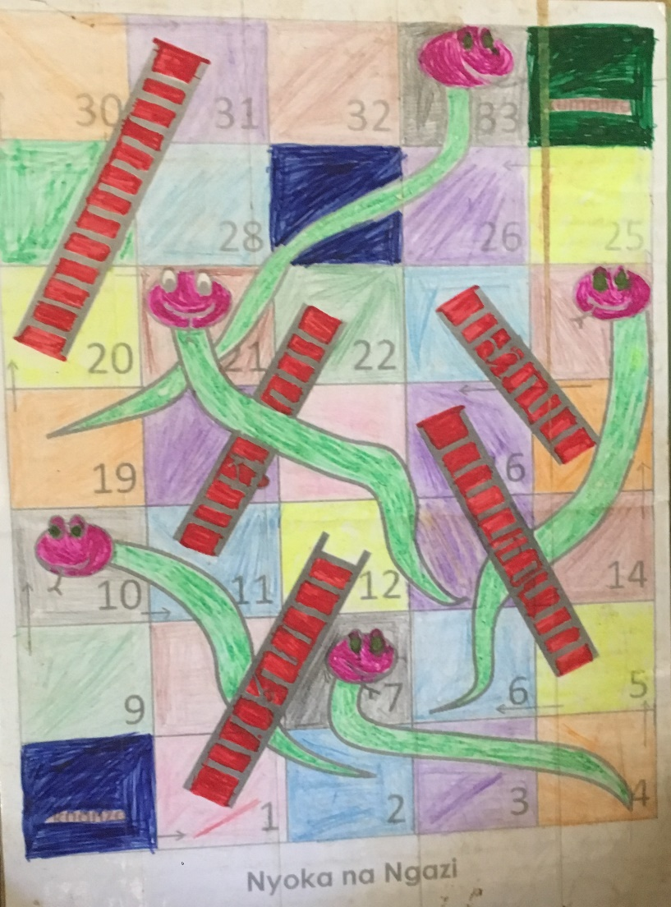
Spillover:
Qualitative findings and respondent voices
Spillover
Clear evidence of spillover of FkW intervention to control schools, particularly in Mwanza.
Evidence that FkW is spreading to Standard 1 and Standard 2 in some schools.
“In our district council we had 20 schools in Fursa. We have tried to make sure all 80 government schools are taught by FkW schools. So, I can say that FkW has helped all 80 schools in our district council to get the training offered through the opportunity for children program.” DAO
“There are notable changes. For example, Misungwi has a standard model because of FKW. We have 145 schools taking part. They have a special class for preprimary education and follow the criteria.” DEO

Slide 36
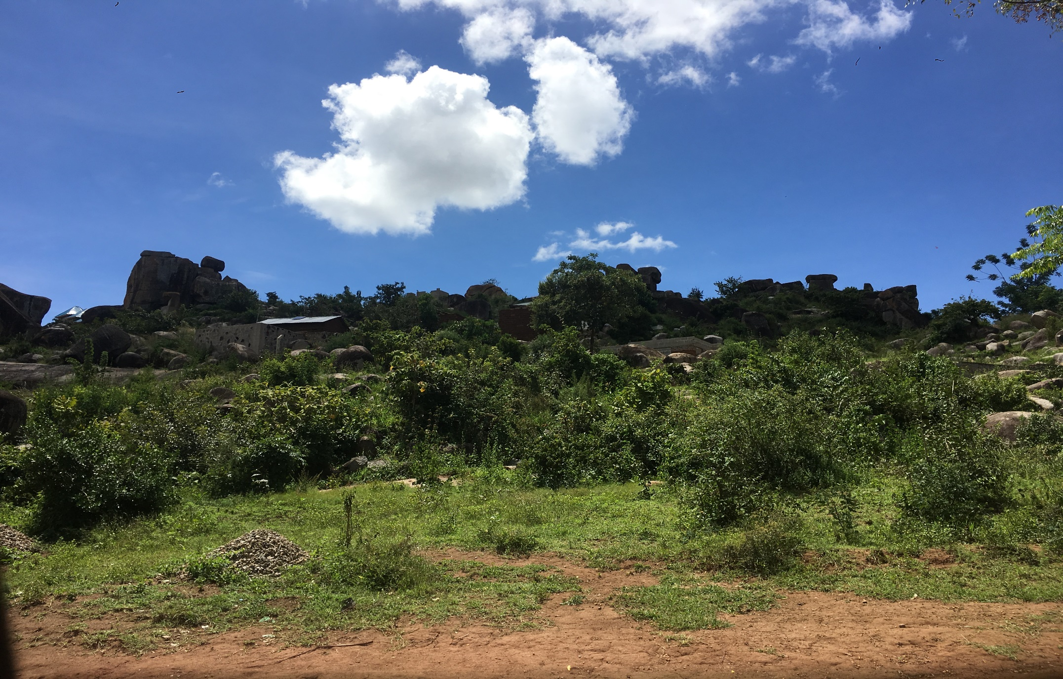
Spillover:
Respondent voices
“[FkW has been so valuable]… and that’s why we were also trying to make [upper grades] too. Standard one should be organized as pre-primary. The walls in the classroom should speak. The child should not she big changes [between grades]. I went and saw Standard 1 … even these schools have teaching tools.”
QAO Mwanza
“First I am proud of what the program has started. This program didn’t touch every school. But by using the morale from schools where the program was implemented, we were able to do this to all the preprimary classrooms. I was visiting every school and teachers from other schools were visiting schools with this program.” WEO Mwanza
“After seeing that our fellows from Kilimanjaro succeeded to a large extent, it made us come back with one agenda. The education officer, professional officer, and I decided: All our schools should adopt the culture from Kilimanjaro. We did something called transferring and spreading knowledge. We told trained teachers to form clusters in their areas and teach those schools that did not get the FKW training. We visit schools that didn’t get the FkW training, and there were big changes. This made me think that it is possible. We found that even these teachers who were not trained were able to gain knowledge and their classes changed. A system similar to Fursa was seen. We succeeded by 95%. Even those schools that were not able to get the FkW opportunity have now adopted Fursa.” QAO Mwanza

Slide 37
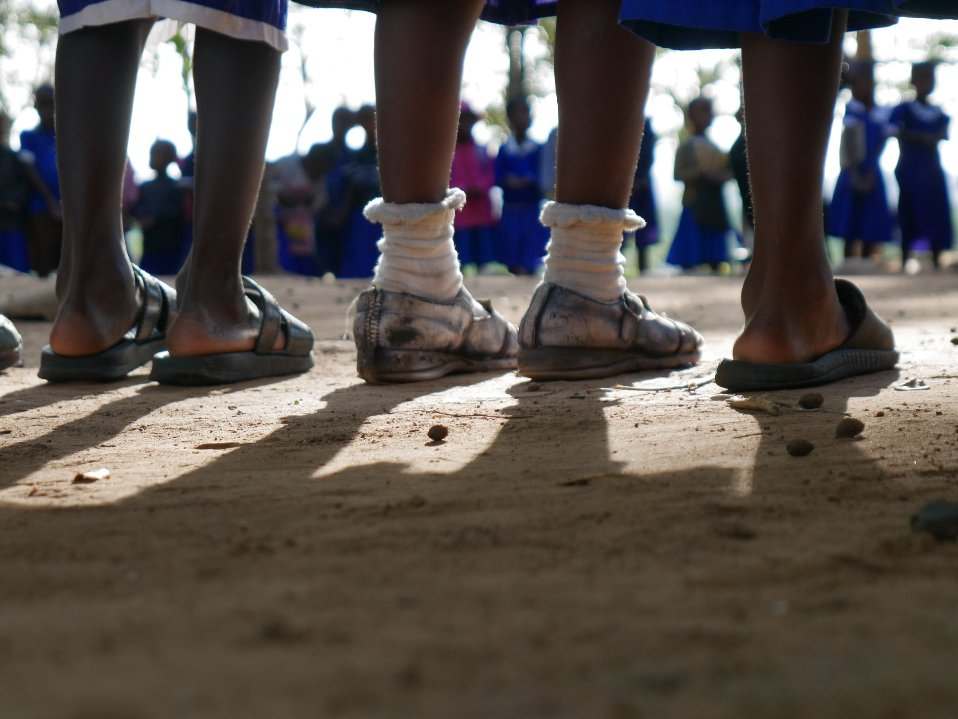
Sustainability

Slide 38
Sustainability:
“Yes, sustainable”
“No, not sustainable”
Quantitative results and qualitative reports from pilot and intervention schools show promising findings indicating that many components of FKW are sustainable
Using learning corners and learning materials
Interactive classrooms
Child led activities
Circle time
Reflective practices
Working in partnership with head teachers, SMCs, WEOs
Teachers may revert to old practices without ongoing teacher training
Without a plan to replace trained teachers who have left, new teachers implement old practices
Without additional support (paraprofessionals) to help manage large classes, teachers are unable to meet students’ diverse learning needs

